Slide 1
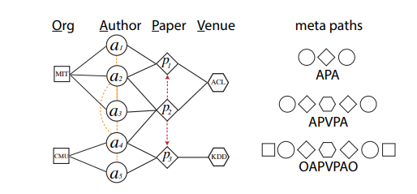
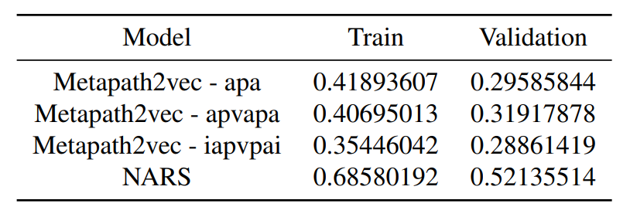
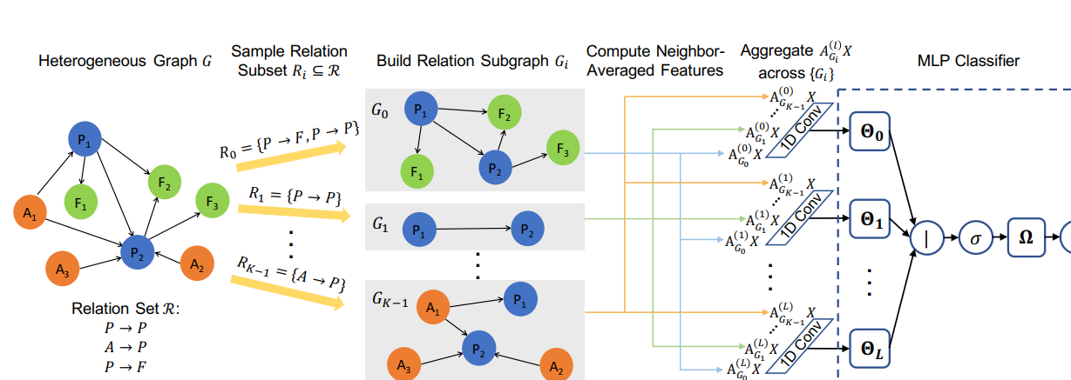
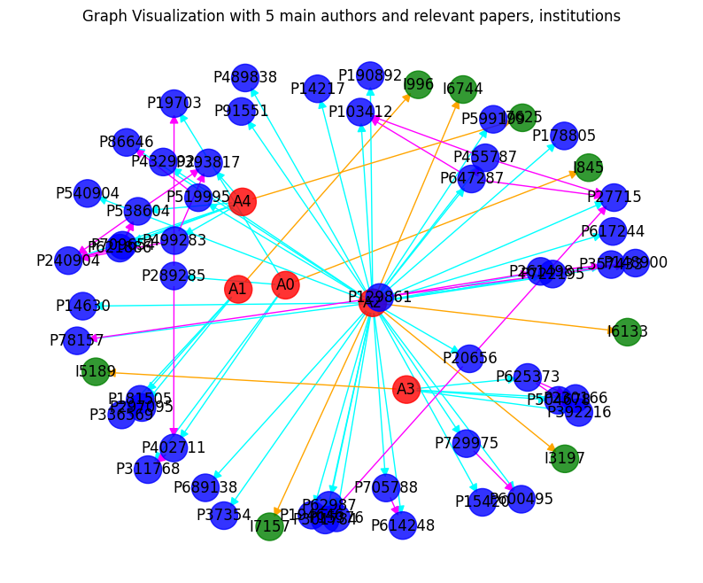
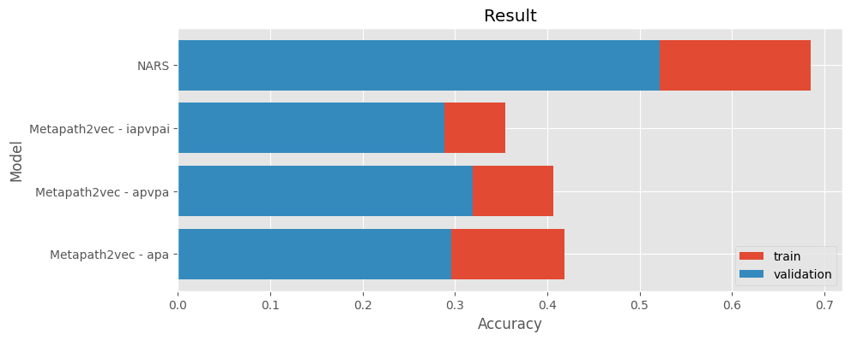
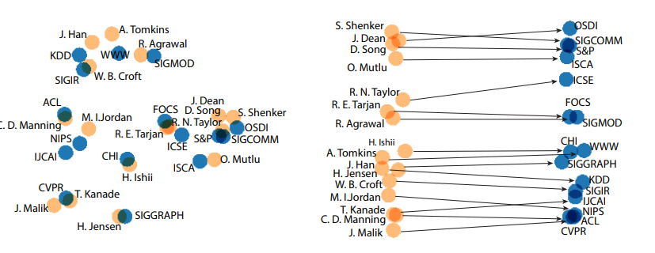

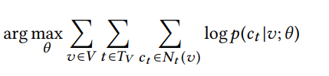
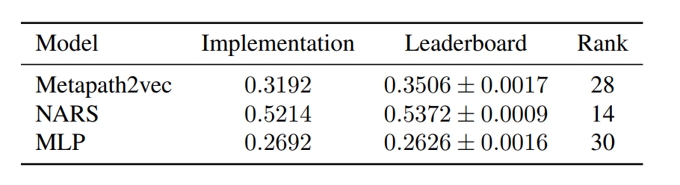
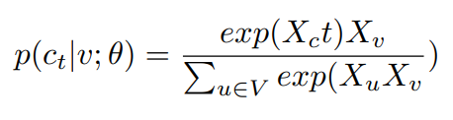
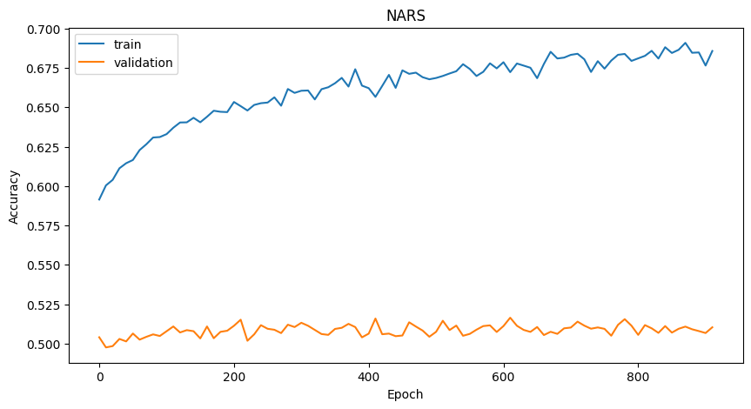
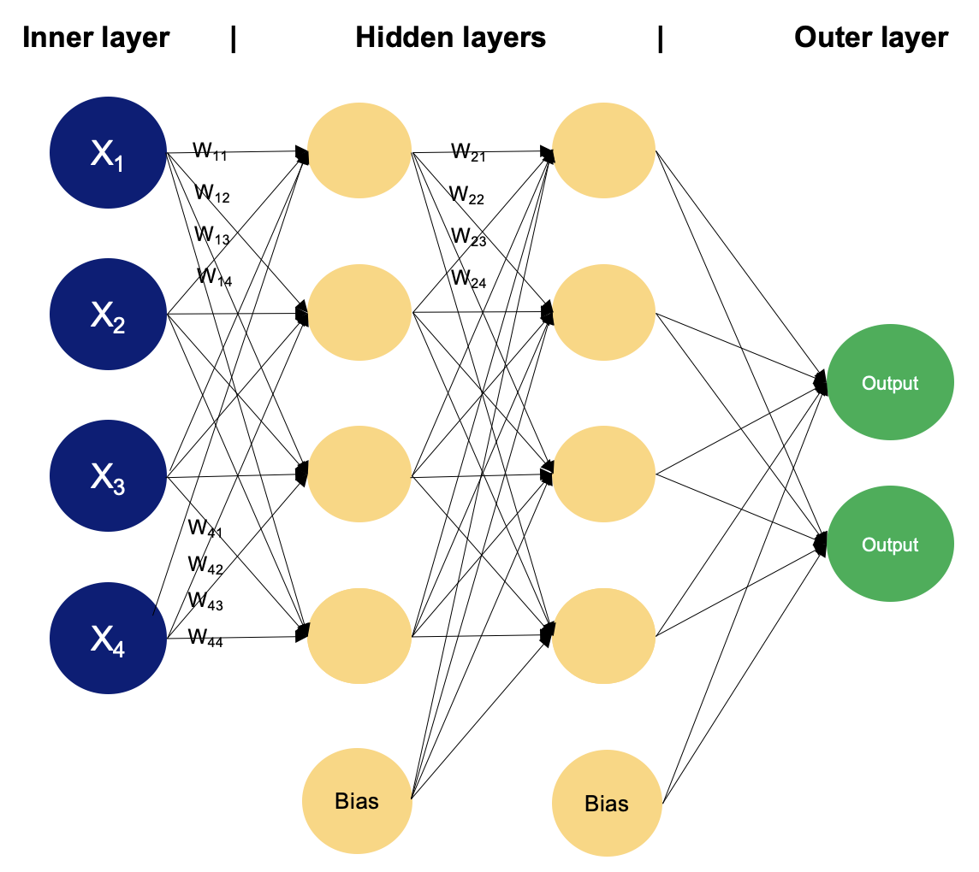

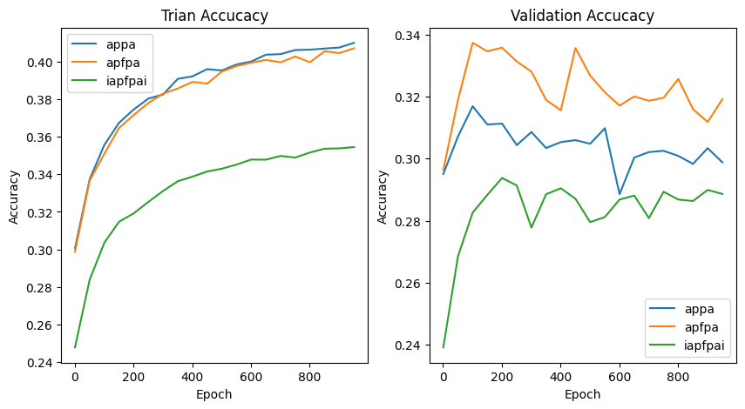
(Graph) Neural Networks for Heterogeneous Graphs: Metapath2vec and NARS
Nikita Bondarciuk (s243888), Frederik Østerbæk Elster (s204256), Xuanqin Yu (s222456) DTU Compute, Technical University of Denmark (DTU)
Introduction
Metapath2vec
NARS
Result
Graphs are powerful structures for capturing relationships but pose challenges when data is incomplete. Using the ogbn-mag dataset we using Metapath2vec and Neighbor Averaging over Relation Subgraphs (NARS) to predict paper venues to improving the Microsoft Academic Graph’s completeness.
The Metapath2vec model is designed for learning representations in heterogeneous networks by using meta-paths to sample random walks on the network and capturing the relationships
NARS leverages entity and relation information by sampling subsets of relation types to create subgraphs, performing neighbor averaging on these subgraphs, and aggregating features with a learned 1D convolution. The aggregated features train an MLP
Comparing our result from the Metapath2ved and NARS model. The NARS model outperformed the metapath2vec model, achieving a validation accuracy of approximately 0.5.
Metapath
³
Embeddings
Neighbor-averaging step:
Furthermore, when comparing our validation accuracy to the leaderboard-reported values our models performed competitively but fell slightly short.
There are four types of nodes in the ogbn-mag data (‘Paper’, ‘Author’, ‘Institution’ and ‘ Field of Study’) and four types of edges indicating relationships between the nodes. The network is very large and therefore is not computational feasible to work on the entire graph.
Skip-gram
where
Negative sampling
Metapath2vec effectively captures meta-path relationships but NARS achieves more robust aggregation through is neighbor averaging.
Conclusion
Use trained embedding in MLP
Our best performing model had a validation accuracy around 0.5 so there is definitely room for improvement. Future work could be incorporating additional methods for the NARS model.
References
[1] Dong, Yuxiao, Nitesh V. Chawla, and Ananthram Swami. "metapath2vec: Scalable Representation Learning for Heterogeneous Networks." Proceedings of the 23rd ACM SIGKDD International Conference on Knowledge Discovery and Data Mining (KDD '17), August 13-17, 2017, Halifax, NS, Canada. DOI: 10.1145/3097983.3098036​(KDD17-dong-chawla-swami…).
[2] Yu, Lingfan, Jiajun Shen, Jinyang Li, and Adam Lerer. "Scalable Graph Neural Networks for Heterogeneous Graphs." Preprint, arXiv:2011.09679, 2020. Available on arXiv​(2011.09679v1).
Notes:
‹#›

Slide 2
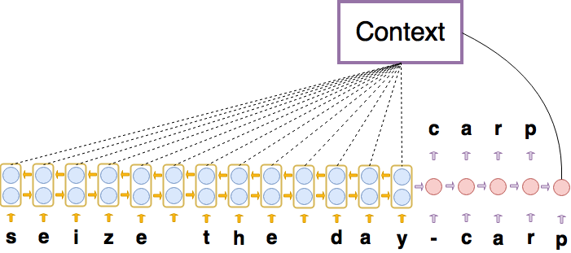
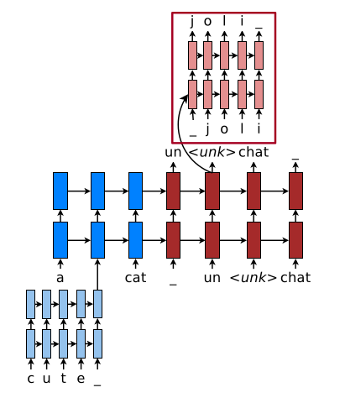
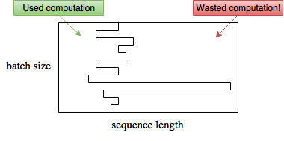
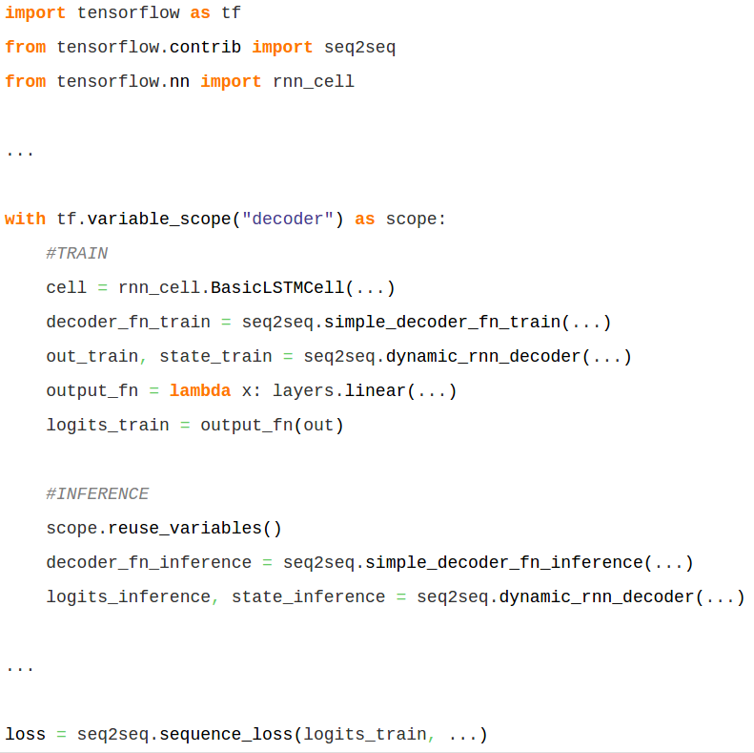
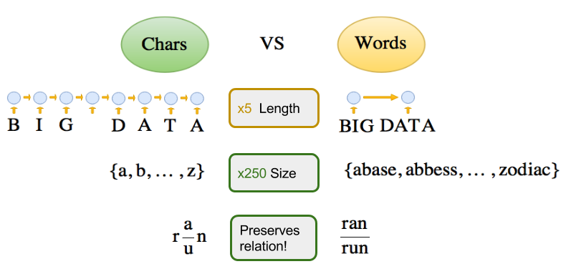
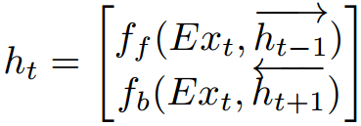
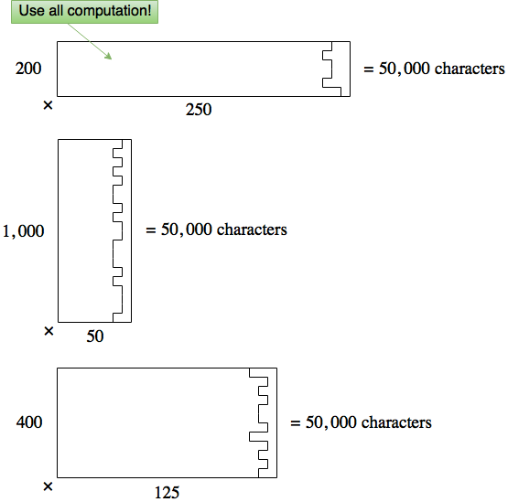
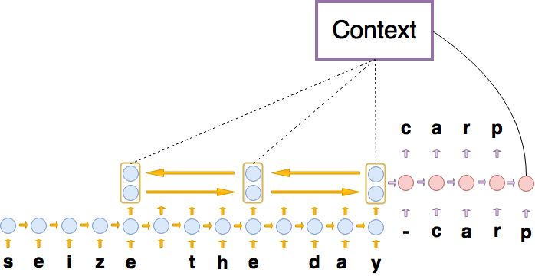
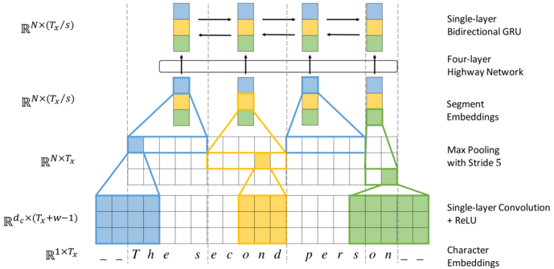

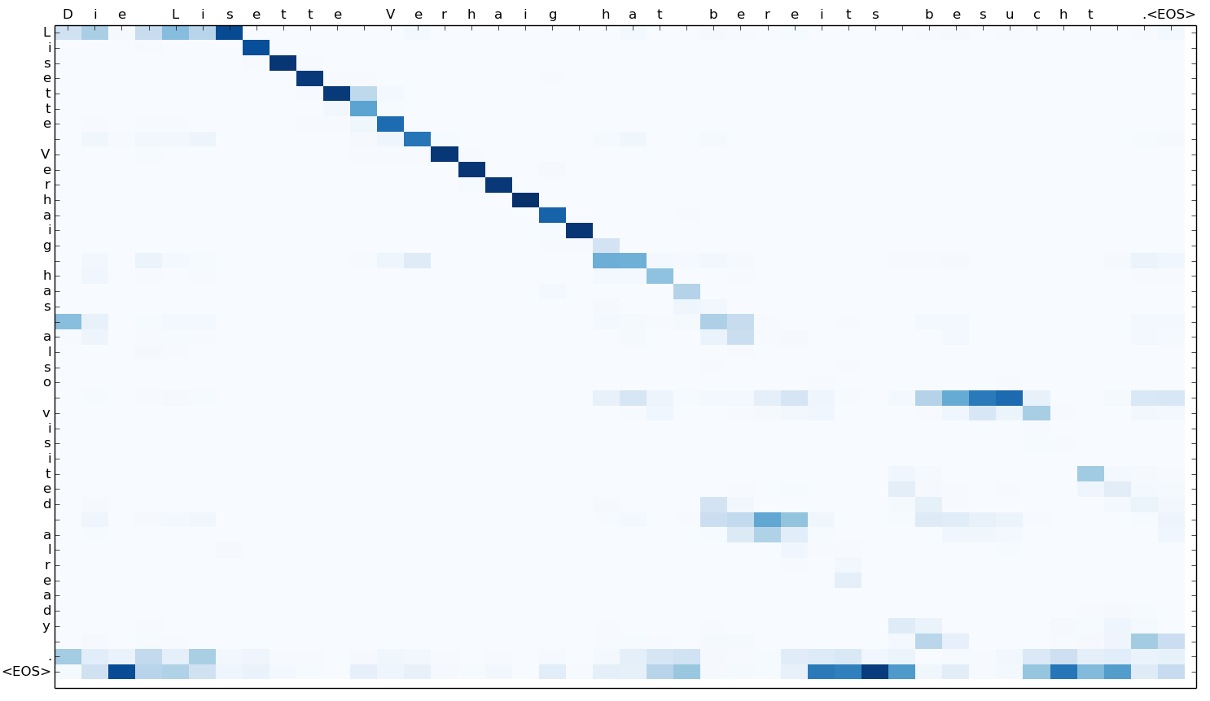
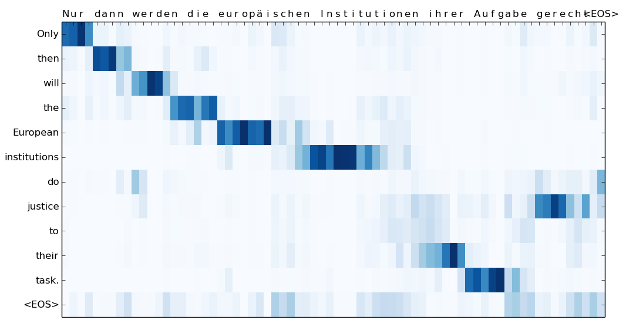
(Graph) Neural Networks for Heterogeneous Graphs: Metapath2vec and NARS
Alexander Rosenberg Johansen, Jonas Meinertz Hansen, Elias Khazen Obeid, Casper Kaae Sønderby, Ole Winther DTU Compute, Technical University of Denmark Bioinformatics Centre, University of Copenhagen
Introduction
Model
Computation
Related Models
Neural machine translation (NMT) uses deep learning to achieve State-Of-The-Art for translation. However, most published NMT uses word-level encodings^{1,2}
char-to-char
Normal batching
Merged to TensorFlow!
Hybrid Word-Character⁶
³
Dynamic batching⁵
Is a RNN memory Cell⁴
char2word-to-char
Character Segmentation⁷
Key contributions:
Char2Word encoder mechanism
Char-to-char seq2seq interpretation
Dynamic Batching
Results - Qualitative
Replaces
Results - Quantitative
char-to-char attention plot
char2word-to-char attention plot
Model | Language | newstest2015
char-to-char | En-De | 15.14 BLEU
char2word-to-char | En-De | 17.43 BLEU
Char-level
References
Word-level
[1] Dzmitry Bahdanau, Kyunghyun Cho, and Yoshua Bengio. Neural machine translation by jointly learning to align and translate. CoRR, 2014.
[2] Ilya Sutskever, Oriol Vinyals, and Quoc V. Le. Sequence to sequence learning with neural networks. CoRR, 2014.
[3] M. Schuster and K.K. Paliwal. Bidirectional recurrent neural networks. Trans. Sig. Proc., 45(11):2673–2681, November 1997.
[4] Sepp Hochreiter and Jürgen Schmidhuber. Long short-term memory. Neural Comput., 9(8):1735–1780, November 1997.
[5] A. Y. Hannun, C. Case, J. Casper, B. Catanzaro, G. Diamos, E. Elsen, R. Prenger, S. Satheesh, S. Sengupta, A. Coates, and A. Y. Ng. Deep speech: Scaling up end-to-end speech recognition. CoRR, 2014.
[6] Minh-Thang Luong and Christopher D. Manning. Achieving open vocabulary neural machine translation with hybrid word-character models. CoRR, 2016.
[7] Jason Lee, Kyunghyun cho, Thomas Hofman. Fully Character-Level Neural Machine Translation without Explicit Segmentation. CoRR, 2016.
Notes:
‹#›

